Slide 1
ProxylessNAS
DARTS
Differentiable Architecture Search

Slide 2
Contents
Introduction (mostly NAS)
Background (mostly CNNs and RNNs)
About DARTS
Results from DARTs
About ProxylessNAS
Results from ProxylessNAS
Conclusion

Slide 3
Introduction
Neural networks are complicated systems and require a lot of tuning to work properly on certain tasks such as image classification or text classification. Parameters of the network are learned by using gradient descent to find a minimum of a loss function that describes the error that the network has on a set of training data. The architecture of these network, until recently, had been hand crafted by researchers.
NAS – Neural Network Architecture Search, are algorithmic solutions to automate the manual process of architecture design. Reinforcement learning has been the most popular for the task but is computationally expensive requiring on the order of thousands of GPU hours to find a suitable setup. The two papers examined in this work, DARTS and ProxylessNAS, propose techniques to create a continuous loss function that includes a representation of the network architecture so that gradient descent can be used to find an optimal architecture in much less time.
Since, both the papers are attempting to find the optimal Neural Network Architecture for CNN’s (DARTS and Proxyless) and RNN’s (DARTS Only). Hence, it would help to briefly overview the functioning of these two varying Neural Networks.

Slide 4
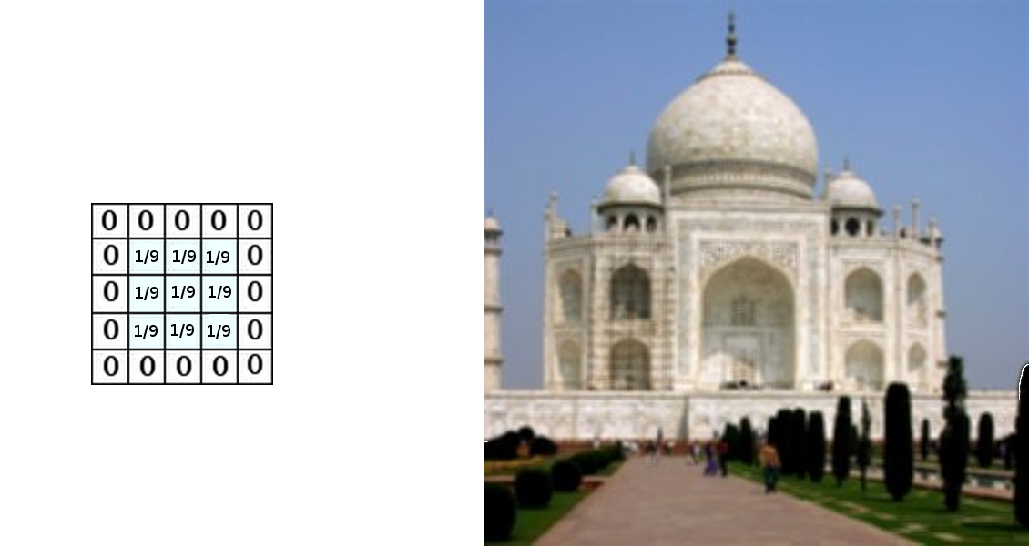
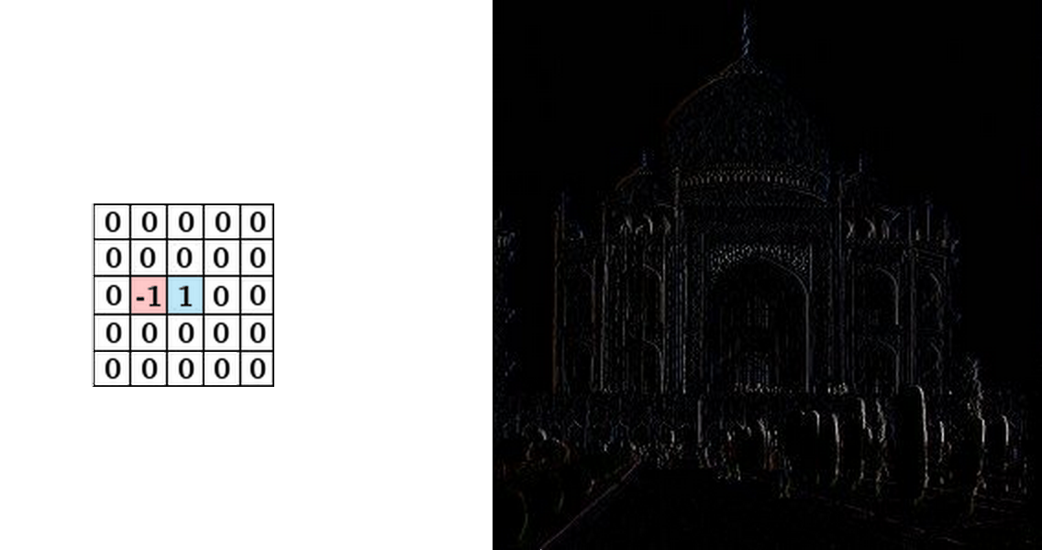
CNN: CONVOLUTIONAL NEURAL NETWORKS
A Convolutional Neural Network (CNN, or ConvNet) is a class of deep neural networks, most commonly used to analyze visual imagery. They usually consist of multiple hidden layers.
Convolutional Layers
Emulates a single neuron. Basically, an N x N Matrix that are used as a feature detector. Output is a feature map which is a representation of the image.
RELU Layers
Used to introduce nonlinearity to a system that has been computing linear operations in the previous layers.
Pooling Layers
Used to reduce the dimensions of the data by combining output of region in a feature layer together. The combination is done by calculating the average of the previous activations, or taking their averages
Fully Connected Layers
Same as the traditional multi-layer perceptron neural network (MLP). The flattened matrix goes through a fully connected layer to classify the images.

Slide 5
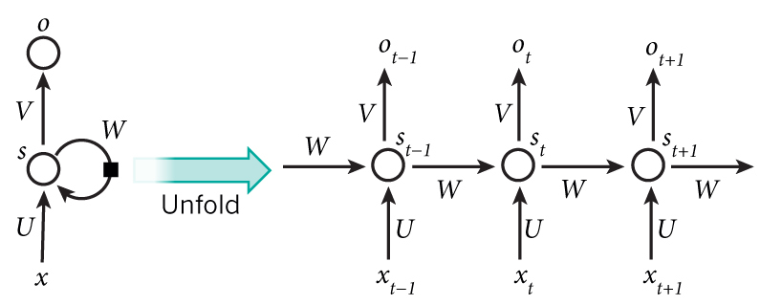
RNN: RECURRENT NEURAL NETWORKS
Recurrent Neural Network (RNN are widely used for language modeling.
It captures information about what has been calculated so far.
We can think of RNNs as multiple copies of the same network, each passing a message to a successor in a sequence.
Each element performs the same task with the output being dependent on the previous element’s computation.
The input to the hidden node in an RNN is both the input at the current timestep, and the value of its own activation in the previous timestep.

Slide 6
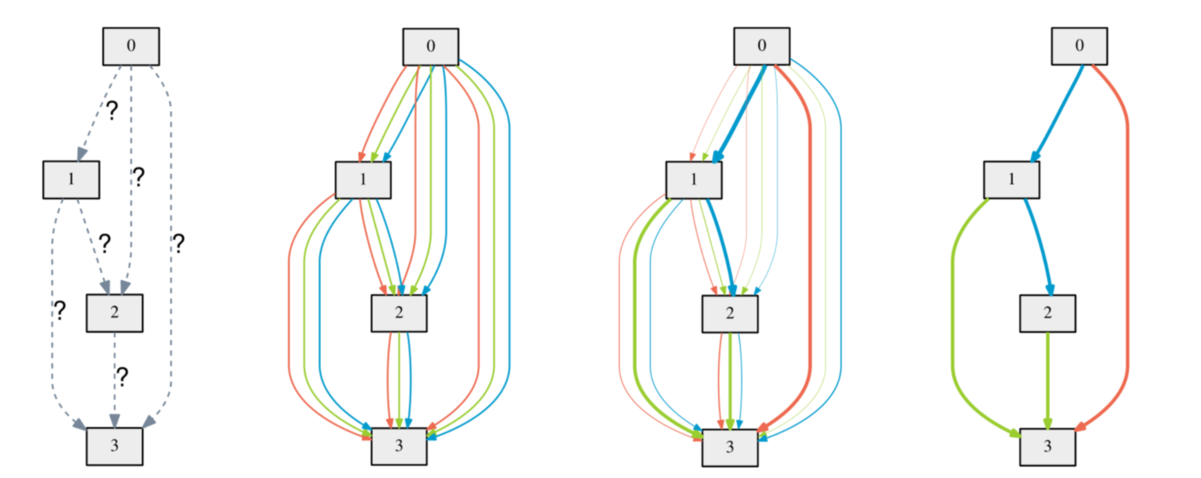
DARTS (Differentiable ARchiTecture Search)
DARTS uses a continuous search space and performs gradient decent on the the Validation Dataset to optimize the Architecture based on a Loss Function.
Unlike the techniques used before it, it does not fine-tune specific aspects of the architecture, but instead learns the entire architecture building block. It is simpler than many existing approaches and can handle both CNNs and RNNs.
It searches for a computation cell as the building block of the final architecture. The learned cell could either be stacked to form a CNN or recursively connected to form an RNN.
A cell is a directed acyclic graph with N nodes. A node could be an output of an operation (like a feature map) and the edges can be the operations (like convolution, max pooling, zero, ReLU) themselves.
It uses joint optimization to obtain the mixing probabilities for the architecture and the network weights.
It needs to optimize:
The weights for the architecture to reduce the training loss on that network.
The architecture, which is evaluated by taking the validation loss of the network with the current architecture using the weights that it optimized already.

Slide 7
Approaches
DARTs
Search Technique
The search begins by computing a SoftMax over all possible operations that can be performed, reducing the architecture to learning a set of continuous variables. SoftMax is used to boost the probability of the operation that has the highest value. A regular max function is non-differentiable, so SoftMax must be used so that the gradients can be computed.
At the end of the search, a discrete architecture is obtained by choosing the most likely operation from the set of all operations. The goal is to jointly learn the architecture α and the weights w within all the mixed operations and using gradient descent to optimize the validation set loss.
Calculating the architecture gradient is extremely expensive for each inner optimization, hence a simple approximation technique is proposed to approximate the training loss by adapting w using only a single training step, without solving the inner optimization. While convergence is not guaranteed, in experiments it is able to reach convergence with a suitable choice for the learning rate of training the neural network with the architecture α.
Look in the slide notes below for topics to consider talking about
Notes:
Consider talking about:
Cybernetics and brain simulation
Symbolic
Sub-symbolic
Statistical learning
Integrating the approaches

Slide 8
DARTS
The experiments consist of two stages,
Architecture search: Cell architectures are searched for using DARTS, and the best ones are chosen based on their performance on the validation set.
Architecture evaluation: Best performing cells are used to construct larger architectures, which are used to train on the test set.
Transferability is also tested using the best cells from the tests on CIFAR-10 and PTB, on ImageNet and WikiText-2 (WT2) respectively.
The architectures to be chosen for evaluation are done by running DARTS four times with random start values and then the best cells are picked based on their validation set performance training for a really short period of time (100 epochs on CIFAR-10 and 300 epochs on PTB). This is important as the optimization techniques could give varying results based on the initialization parameters.
Once the architectures are selected, the architectures are initialized with random weights, trained from scratch and results are reported based on the performance on the test set. The best cells from the selected architectures are evaluated on ImageNet (mobile setting) and WikiText-2, by stacking them on top of each other..
Notes:
Consider talking about:
Search and optimization
Logic
Probabilistic methods for uncertain reasoning
Classifiers and statistical learning methods
Artificial neural networks
Evaluating progress

Slide 9
Applications
DARTS
Results
DARTs was able to provide the lowest error rates and text perplexity for CIFAR-10 and PTB, respectively, when compared to other NAS Algorithms.
DARTS required the least number of parameters and the lowest number of GPU days.
On CIFAR-10, DARTS required 1.5 or 4 GPU days vs 2000 GPU days for NASNet and 3150 GPU days for AmoebaNet and with a slightly longer search time, DARTS outperformed ENAS by discovering cells with comparable error rates but less parameters.
Competitive random search results for both convolutional and recurrent models, which reflects the importance of the search space design. DARTS can significantly improve upon random search
Experiments with the cell learned on CIFAR-10 can be transferred to ImageNet. DARTS also transfers to WikiText2 better than ENAS.
Look in the slide notes below for topics to consider talking about
Notes:
Consider talking about:
Healthcare
Automotive
Finance and economics
Video games
Military
Audit
Advertising
Art

Slide 10
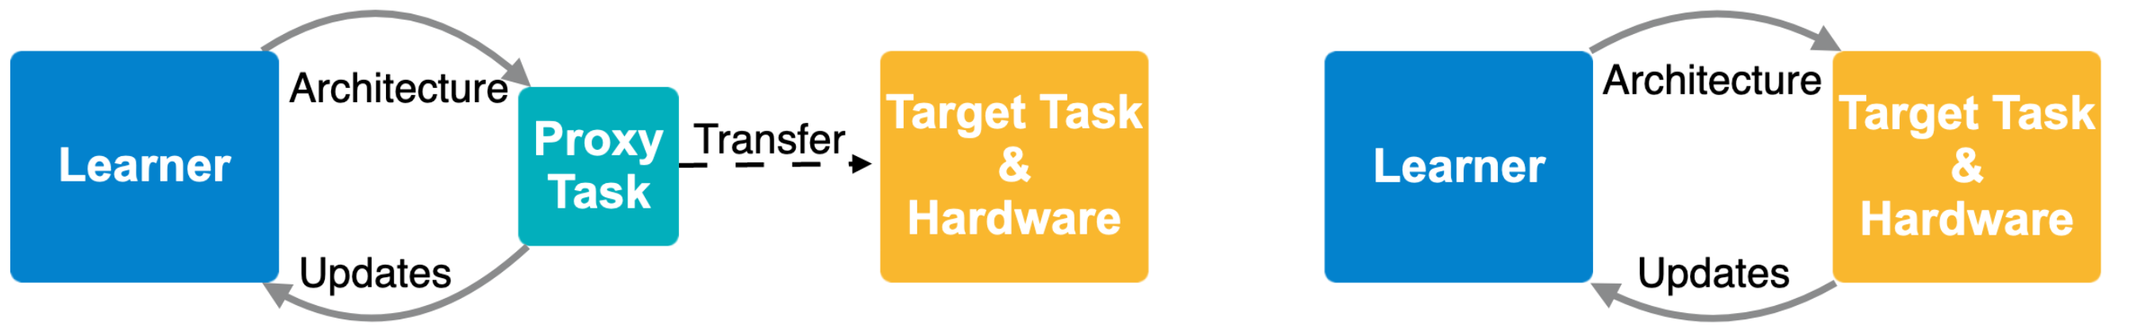
DARTS PROXYLESSNAS
Differentiable architecture search is much faster than previous techniques, but it requires a lot of GPU memory.
DARTS train the architecture on a smaller, proxy, task like a subset of CIFAR-10.
The trained architecture is then used on the true target task such as ImageNet.
Architecture is not tailored to the true task that it was meant to solve so it is unlikely to be the best architecture for the job.
ProxylessNAS learns different architectures for different target hardware and target task.
ProxylessNAS trains the architecture on the target task and hardware.
The architecture trained for a GPU can take advantage of the parallelism that the hardware provides and is tested directly on the target task.
A differentiable function to model the performance of different devices is used, so that the architecture can be learned for a specific device. So the architectures searched will be the best for the task.
Look in the slide notes below for topics to consider talking about
Notes:
Consider talking about:
The limits of artificial general intelligence
Potential harm
Ethical machines
Machine consciousness, sentience and mind
Superintelligence

Slide 11
PROXYLESSNAS
DARTS. requires a large amount of memory to store all the nodes in a network (architecture), their weights and the outputs. For N paths through the network representation it need N times the amount of GPU memory to train the network compared to a regular CNN. The solution was to search for small components of the network, called blocks, and put them together to form a larger network.
ProxylessNAS uses a similar technique for representing the architecture. A set of nodes, that make up the network and model connections, are created.
A network much larger than DARTs is created, containing all the candidate operations connecting each of the nodes together. This over-parameterized network is too large to train on using DARTS.
Instead of using all the paths in the network at once, the paths weights are binarized so that only one is used at a time.
In the network representation there are weights on all the paths that connect the nodes together. If the path weight is low, that means the connection is unlikely to be useful. If the path weight is high, then it should be a part of the final architecture.

Slide 12
PROXYLESSNAS
Search Technique
Binarizing the path weights means that they are setting edge weights for the selected path to 1 and all others to 0. Paths are selected randomly throughout the network during training. Using this technique, they save more than an order of magnitude of memory.
Each batch of input data is passed through the model, a new path is randomly selected through the network using the path weights as the distribution to sample from. Then the weight parameters on the currently selected path are updated. So as a batch of image data is passed through the network, the weights of the convolution kernels would be updated.
During this part of the training, the architecture parameters remain constant. Then using this path, the loss is calculated on the validation set and the gradient with respect to the architecture parameters is calculated, while the weights of the selected path are kept constant.
With the gradient computed, the architecture parameters can be updated so now a different path may have higher weights. Freezing one set of weights when training on the other, for example freezing architecture weights when training the network, also helps reduce memory consumption.

Slide 13
PROXYLESSNAS
Training for specific hardware
To train the architecture for different hardware the overall latency, which is the time it takes for a given architecture to predict a result for an input, of the network needed to be reduced. Latency was used instead of FLOPs because GPUs can run operations in parallel so FLOPs would not be a good indication of response time on that platform.
Latency was modelled as a continuous function of an operation, such as conv 3x3 or max pooling. The latency function can be changed depending on the target hardware.
The total latency for the network is the latency of each operation in the over-parameterized network weighted by its probability of ending up in the final architecture. The overall latency is a function of the architecture so the gradient of this function with respect to the architecture can be computed to reduce latency. The latency of the architecture is added to the overall loss function.
Large network weights can be a sign of an unstable network, where even small changes in the input can lead to large changes in the output. It is also a sign that the network is overfitting the training dataset which can lead to poor performance on test data. To avoid such an issue, a weight regularization term is added to the loss function.
The weight regularization and the latency term are multiplied by scale factors which are hyperparameters so the sensitivity of the loss function to the weights and latency can be adjusted.

Slide 14
PROXYLESSNAS
Results
ProxylessNAS was able to achieve state-of-the-art results in a few different categories.
On CIFAR-10 it got 2.08% test error compared to the 2.13% achieved by AmoebaNet-B, a marginal improvement, but uses only 5.7 million parameters while AmoebaNet-B uses 34.9 million.
On ImageNet evaluated on a GPU, it also achieved state-of-the-art accuracy, getting 75.1% while the previous best was 72%. When testing ImageNet on a mobile platform it achieved state-of-the-art accuracy when evaluations must be under 80ms, it ran in 78ms and was 74.6% accurate.
Without latency regularization, the architecture search finds one with 158ms of latency on the Pixel 1, so it is necessary to explicitly train for it.
Search cost is also much lower than the other methods. It takes 200 GPU hours to search for an architecture while the next best is 40,000 GPU hours.

Slide 15
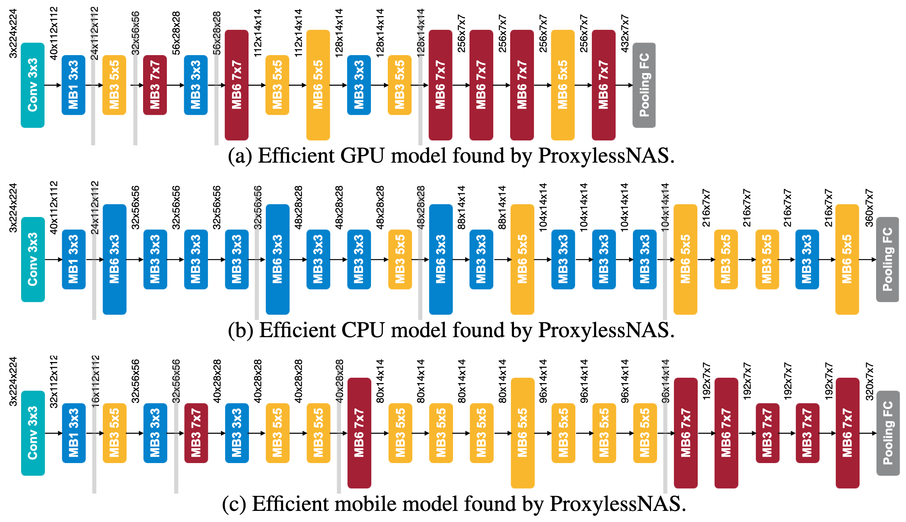
the detailed architectures of searched CNN models on three hardware platforms
The architecture shows different preferences when targeting different platforms. The GPU model is shallower and wider, especially in early stages where the feature map has higher resolution.
The GPU model prefers large MBConv operations (e.g. 7×7 MBConv6), while the CPU model prefers smaller MBConv operations. Because a GPU has much higher parallelism than CPU, so it can take advantage of large MBConv operations.
These kinds of patterns cannot be captured in previous NAS methods as they force the blocks to share the same structure.

Slide 16
Conclusion
The papers talk about two different techniques to perform Neural Network Architecture Search.
They both use a continuous search space and use gradient descent to minimize the loss based on the architecture and weights.
DARTs works on smaller proxy tasks, due to the high memory constraint, whereas ProxylessNAS focuses on the target task and uses latency to improve architecture efficiency on specific hardware.
In DARTs, the architecture developed on proxy tasks is stacked on top of each other to create larger networks, but such networks are not complex enough to handle larger tasks. ProxylessNAS on the other hand builds large complex networks for the target task and hardware, that achieve higher efficiency than other searched networks.

